Slide 1


Principle of Computer Networks Experiment
Lecture: Bo Yang
Professor at School of CS
Northwestern Polytechinal University
Fall semester 2022
yang_bo@nwpu.edu.cn

Slide 2

This is our first lesson, so let’s know each other better ! (each 50mins, we have a short 10mins break )

Slide 3
Goals of this lesson
Wireless networks protocols & analysis via Wireshark
Overview
Application layer
HTTP
Transport layer
TCP
UDP

Slide 4
Goals of this lesson
Wireless networks protocols & analysis via Wireshark
Overview
Application layer
HTTP
Transport layer
TCP
UDP

Slide 5
Network Layers Example: organization of air travel
end-to-end transfer of person plus baggage
ticket (purchase)
baggage (check)
gates (load)
runway takeoff
airplane routing
ticket (complain)
baggage (claim)
gates (unload)
runway landing
airplane routing
airplane routing
How would you define/discuss the system of airline travel?
a series of steps, involving many services

Slide 6
Example: organization of air travel
ticket (purchase)
baggage (check)
gates (load)
runway takeoff
airplane routing
ticketing service
ticket (complain)
baggage (claim)
gates (unload)
runway landing
airplane routing
baggage service
gate service
runway service
routing service
airplane routing
layers: each layer implements a service
via its own internal-layer actions
relying on services provided by layer below

Slide 7
Layered Internet protocol stack
application: supporting network applications
HTTP, IMAP, SMTP, DNS
transport: process-process data transfer
TCP, UDP
network: routing of datagrams from source to destination
IP, routing protocols
link: data transfer between neighboring network elements
Ethernet, 802.11 (WiFi)
physical: bits “on the wire”
application
application
transport
transport
network
network
link
link
physical
physical

Slide 8

Services, Layering and Encapsulation
application
transport
network
link
physical
M
application
transport
network
link
physical
Application exchanges messages to implement some application service using services of transport layer
H_{t}
M
Transport-layer protocol transfers M (e.g., reliably) from one process to another, using services of network layer
transport-layer protocol encapsulates application-layer message, M, with transport layer-layer header H_{t} to create a transport-layer segment
H_{t} used by transport layer protocol to implement its service
source
destination

Slide 9
Services, Layering and Encapsulation
application
transport
network
link
physical
M
application
transport
network
link
physical
H_{t}
M
Transport-layer protocol transfers M (e.g., reliably) from one process to another, using services of network layer
H_{n}
H_{t}
M
Network-layer protocol transfers transport-layer segment [H_{t} | M] from one host to another, using link layer services
network-layer protocol encapsulates transport-layer segment [H_{t} | M] with network layer-layer header H_{n} to create a network-layer datagram
H_{n} used by network layer protocol to implement its service
source
destination

Slide 10
Services, Layering and Encapsulation
H_{n}
H_{t}
M
application
transport
network
link
physical
M
application
transport
network
link
physical
H_{t}
M
H_{n}
H_{t}
M
Network-layer protocol transfers transport-layer segment [H_{t} | M] from one host to another, using link layer services
H_{l}
H_{n}
H_{t}
M
Link-layer protocol transfers datagram [H_{n}| [H_{t} |M] from host to neighboring host, using network-layer services
link-layer protocol encapsulates network datagram [H_{n}| [H_{t} |M], with link-layer header H_{l} to create a link-layer frame
source
destination

Slide 11
Services, Layering and Encapsulation
application
transport
network
link
physical
M
application
transport
network
link
physical
M
message
H_{t}
M
H_{t}
M
segment
H_{n}
H_{t}
M
H_{n}
H_{t}
M
datagram
H_{l}
H_{n}
H_{t}
M
H_{l}
H_{n}
H_{t}
M
frame
source
destination

Slide 12
ISO/OSI reference model
Two layers not found in Internet protocol stack!
presentation: allow applications to interpret meaning of data, e.g., encryption, compression, machine-specific conventions
session: synchronization, checkpointing, recovery of data exchange
Internet stack “missing” these layers!
these services, if needed, must be implemented in application
application
presentation
session
transport
network
link
physical
The seven layer OSI/ISO
reference model

Slide 13


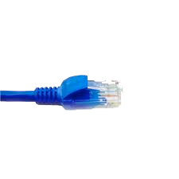
Wireshark – Getting started !
application
(www browser,
email client)
packet
analyzer
application
OS
packet
capture
(pcap)
Transport (TCP/UDP)
Network (IP)
Link (Ethernet)
Physical
copy of all Ethernet frames sent/received

Slide 14
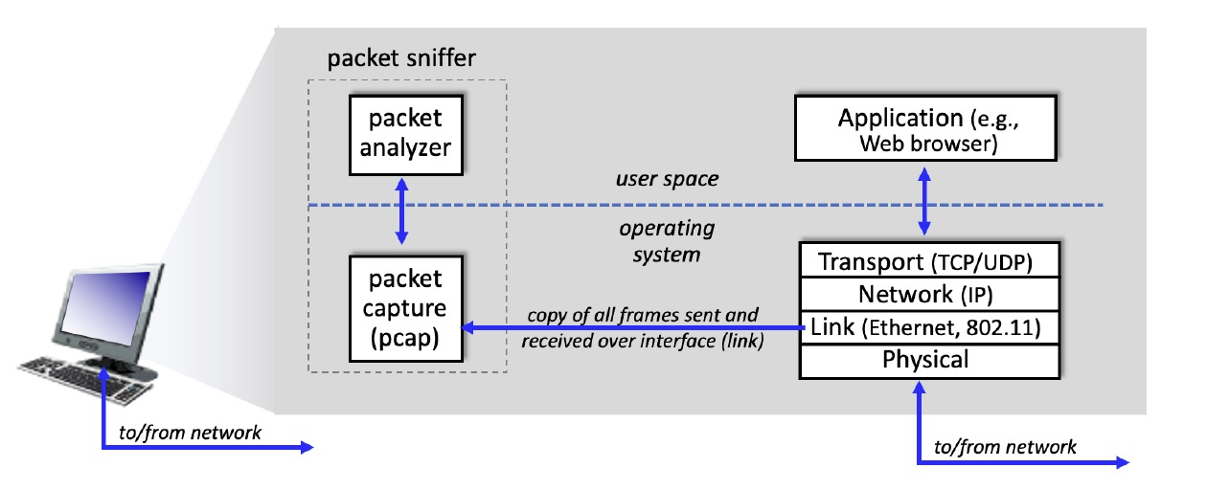
Packet sniffer
The basic tool for observing the messages exchanged between executing protocol entities is called a packet sniffer. A packet sniffer captures (“sniffs”) messages being sent/received from/by your computer.

Slide 15
Two modules of packet sniffer
Packet capture module: capturing all link-layer frames thus gives you all messages sent/received across the monitored link from/by all protocols and applications executing in your computer.

Slide 16
Two modules of packet sniffer
Packet analyzer module: displays the contents of all fields within a protocol message. In order to do so, the packet analyzer must “understand” the structure of all messages exchanged by protocols.

Slide 17

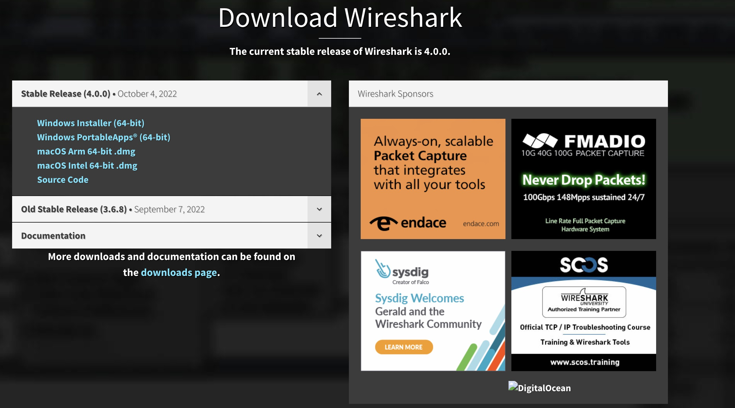
Wireshark packet sniffer
Wireshark is a free network protocol analyzer that runs on Windows, Mac, and Linux/Unix computers: http://www.wireshark.org/ (Download and install it now! 5 mins)
User guide at https://www.wireshark.org/docs/wsug_html_chunked/

Slide 18
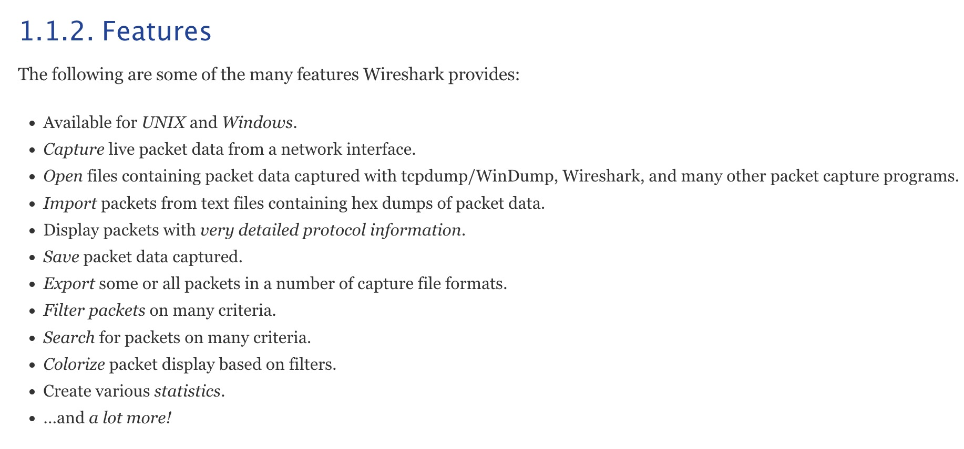
Getting Wireshark
Wireshark is with rich functionality that includes the capability to analyze hundreds of protocols and a well-designed user interface.
It operates in computers using Ethernet, 802.11 (WiFi) wireless LANs, and many other link-layer technologies.

Slide 19
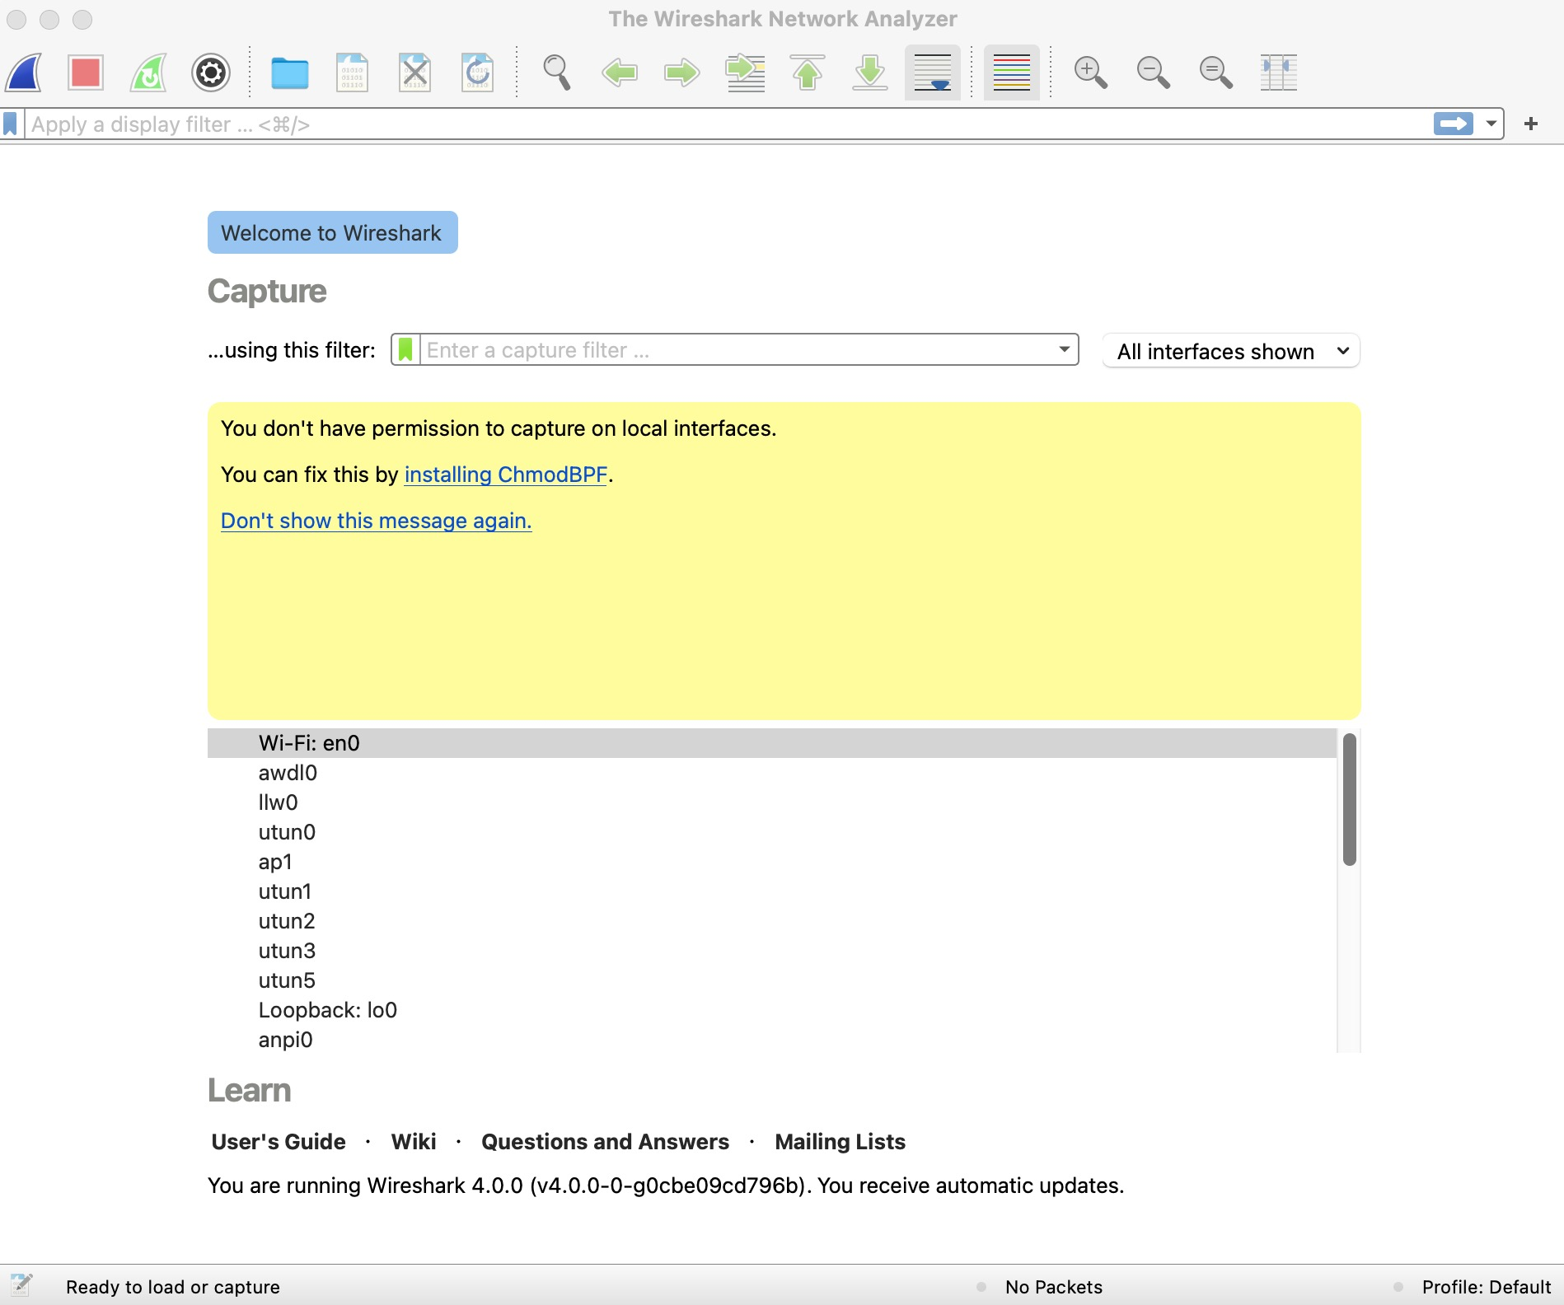
Start to run!
In order to run Wireshark, you’ll need to have access to a computer that supports both Wireshark and libpcap or WinPCap packet capture library.
When you run the Wireshark program, different versions of Wireshark will have different startup screens - so don’t panic if yours doesn’t look exactly like the screen below!

Slide 20
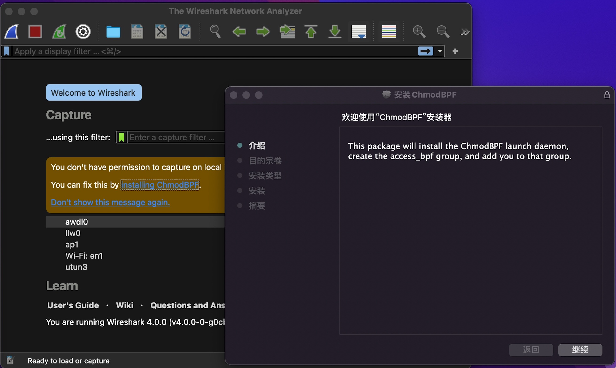
Start to run!
This may happen in your first time use (lost of a package):
Try it now! (2mins)

Slide 21
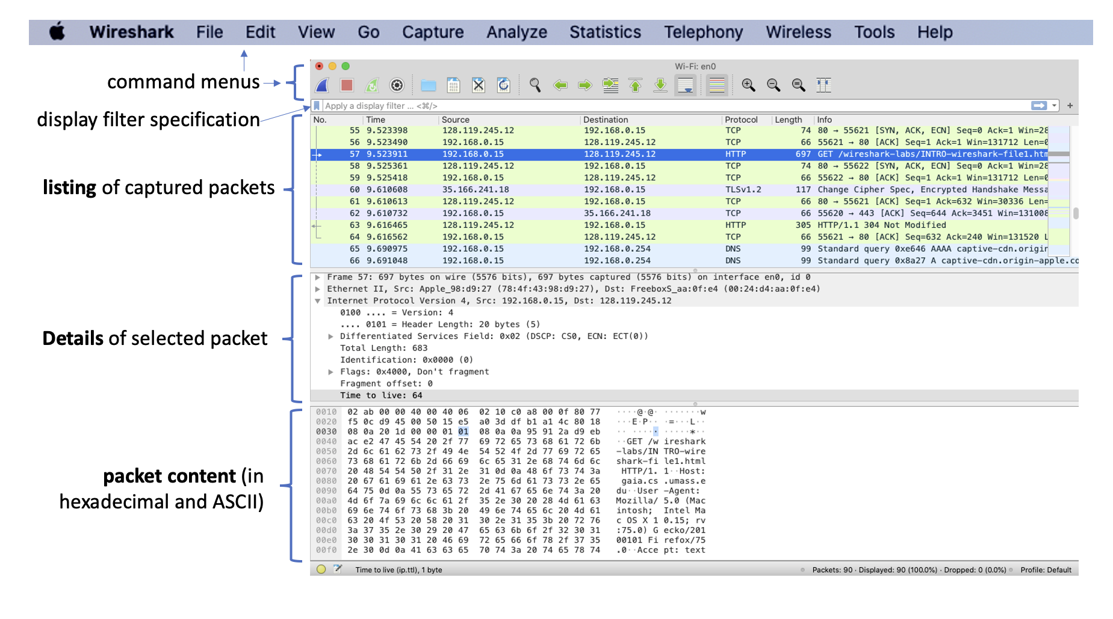










What it looks like?

Slide 22

Five major components
1. Command menus
Of interest to us now are the File and Capture menus.
The File menu allows you to save captured packet data or open a file containing previously captured packet data and exit the Wireshark application.
The Capture menu allows you to begin packet capture.

Slide 23
Five major components
2. Packet-listing window
displays a one-line summary for each packet captured, including:
the packet number (assigned by Wireshark; note that this is not a packet number contained in any protocol’s header)
the time at which the packet was captured;
the packet’s source and destination addresses;
the protocol type, and protocol-specific information contained in the packet.

Slide 24

Five major components
3. Packet-header details window
provides details about the packet selected (highlighted) in the packet-listing window, including:
Ethernet frame (assuming the packet was sent/received over an Ethernet interface)
IP datagram that contains this packet.
Note that if the packet has been carried over TCP or UDP, TCP or UDP details will also be displayed!

Slide 25

Five major components
4. Packet-contents window
displays the entire contents of the captured frame, in both ASCII and hexadecimal format.

Slide 26



Five major components
5. Packet display filter field
a protocol name or other information can be entered in order to filter the information displayed in the packet-listing window.

Slide 27
Taking Wireshark for a Test Run
The best way to learn about any new piece of software is to try it out! We’ll assume that your computer is connected to the Internet via a wired Ethernet interface or a wireless 802.11 WiFi interface.
1. Start up your web browser, which will display your selected homepage.
2. Start up the Wireshark software. You will initially see a window similar to that shown below. Wireshark has not yet begun capturing packets.

Slide 28
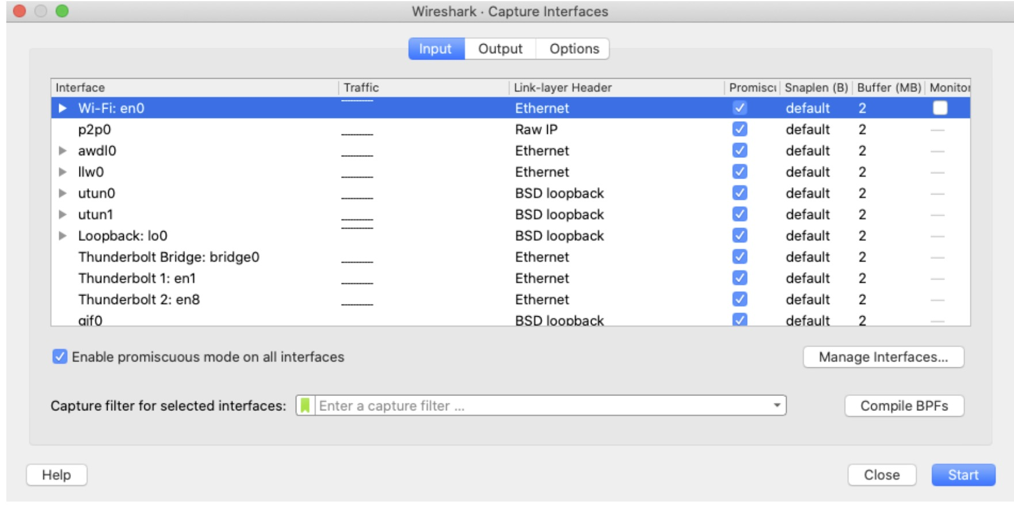

Taking Wireshark for a Test Run
3. To begin packet capture, select the Capture pull-down menu and select Interfaces. This will cause the “Wireshark: Capture Interfaces” window to be displayed. You should see a list of interfaces, as shown in the figure below.

Slide 29
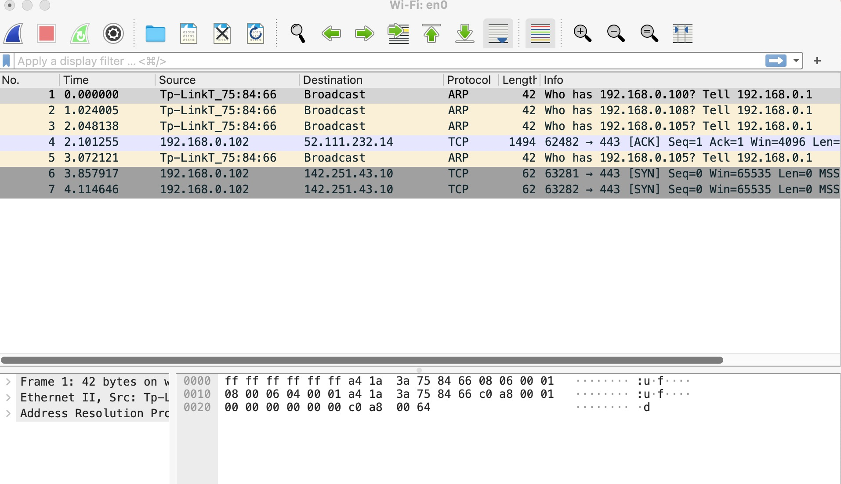


Taking Wireshark for a Test Run
4. You’ll see a list of the interfaces on your computer as well as a count of the packets that have been observed on that interface so far. On a Windows machine, click on Start for the interface on which you want to begin packet capture.
Show me your screen?

Slide 30
Let’s capture some interesting packets!
We’ll need to generate some network traffic. Let’s do so using a web browser, which will use the HTTP protocol that we will study in detail in class to download content from a website.
1. While Wireshark is running, enter the URL: http://gaia.cs.umass.edu/wireshark-labs/INTRO-wireshark-file1.html and have that page displayed in your browser.
In order to display this page, your browser will contact the HTTP server at gaia.cs.umass.edu and exchange HTTP messages with the server in order to download this page.

Slide 31

Let’s capture some interesting packets!
2. After your browser has displayed the INTRO-wireshark-file1.html page (it is a simple one-line of congratulations), stop Wireshark packet capture by selecting stop in the Wireshark capture window.

Slide 32
Taking Wireshark for a Test Run
Note: Once you begin packet capture, a window similar to that shown below will appear. This window shows the packets being captured. By selecting Capture pulldown menu and selecting Stop, or by click on the red Stop square, you can stop packet capture.

Slide 33
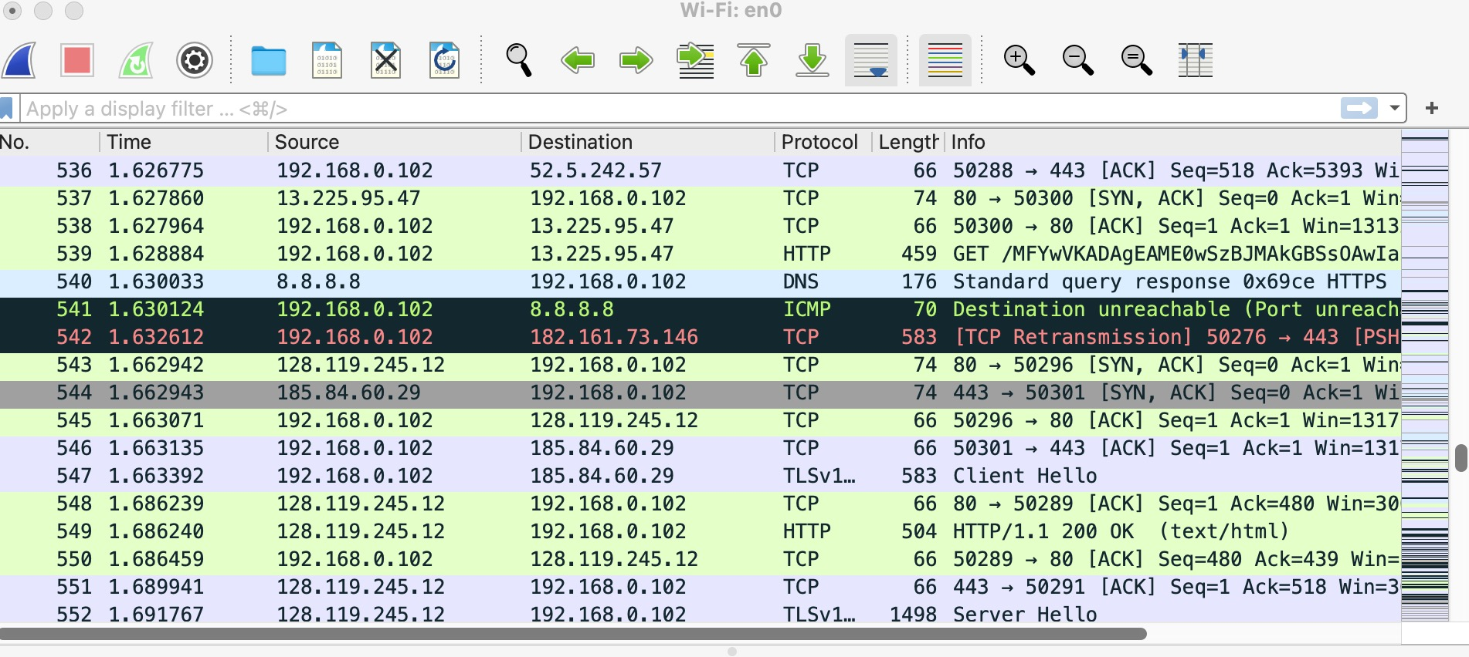
Let’s capture some interesting packets!
Note: The HTTP message exchanges with the gaia.cs.umass.edu web server should appear somewhere in the listing of packets captured. But there will be many other types of packets displayed as well.

Slide 34
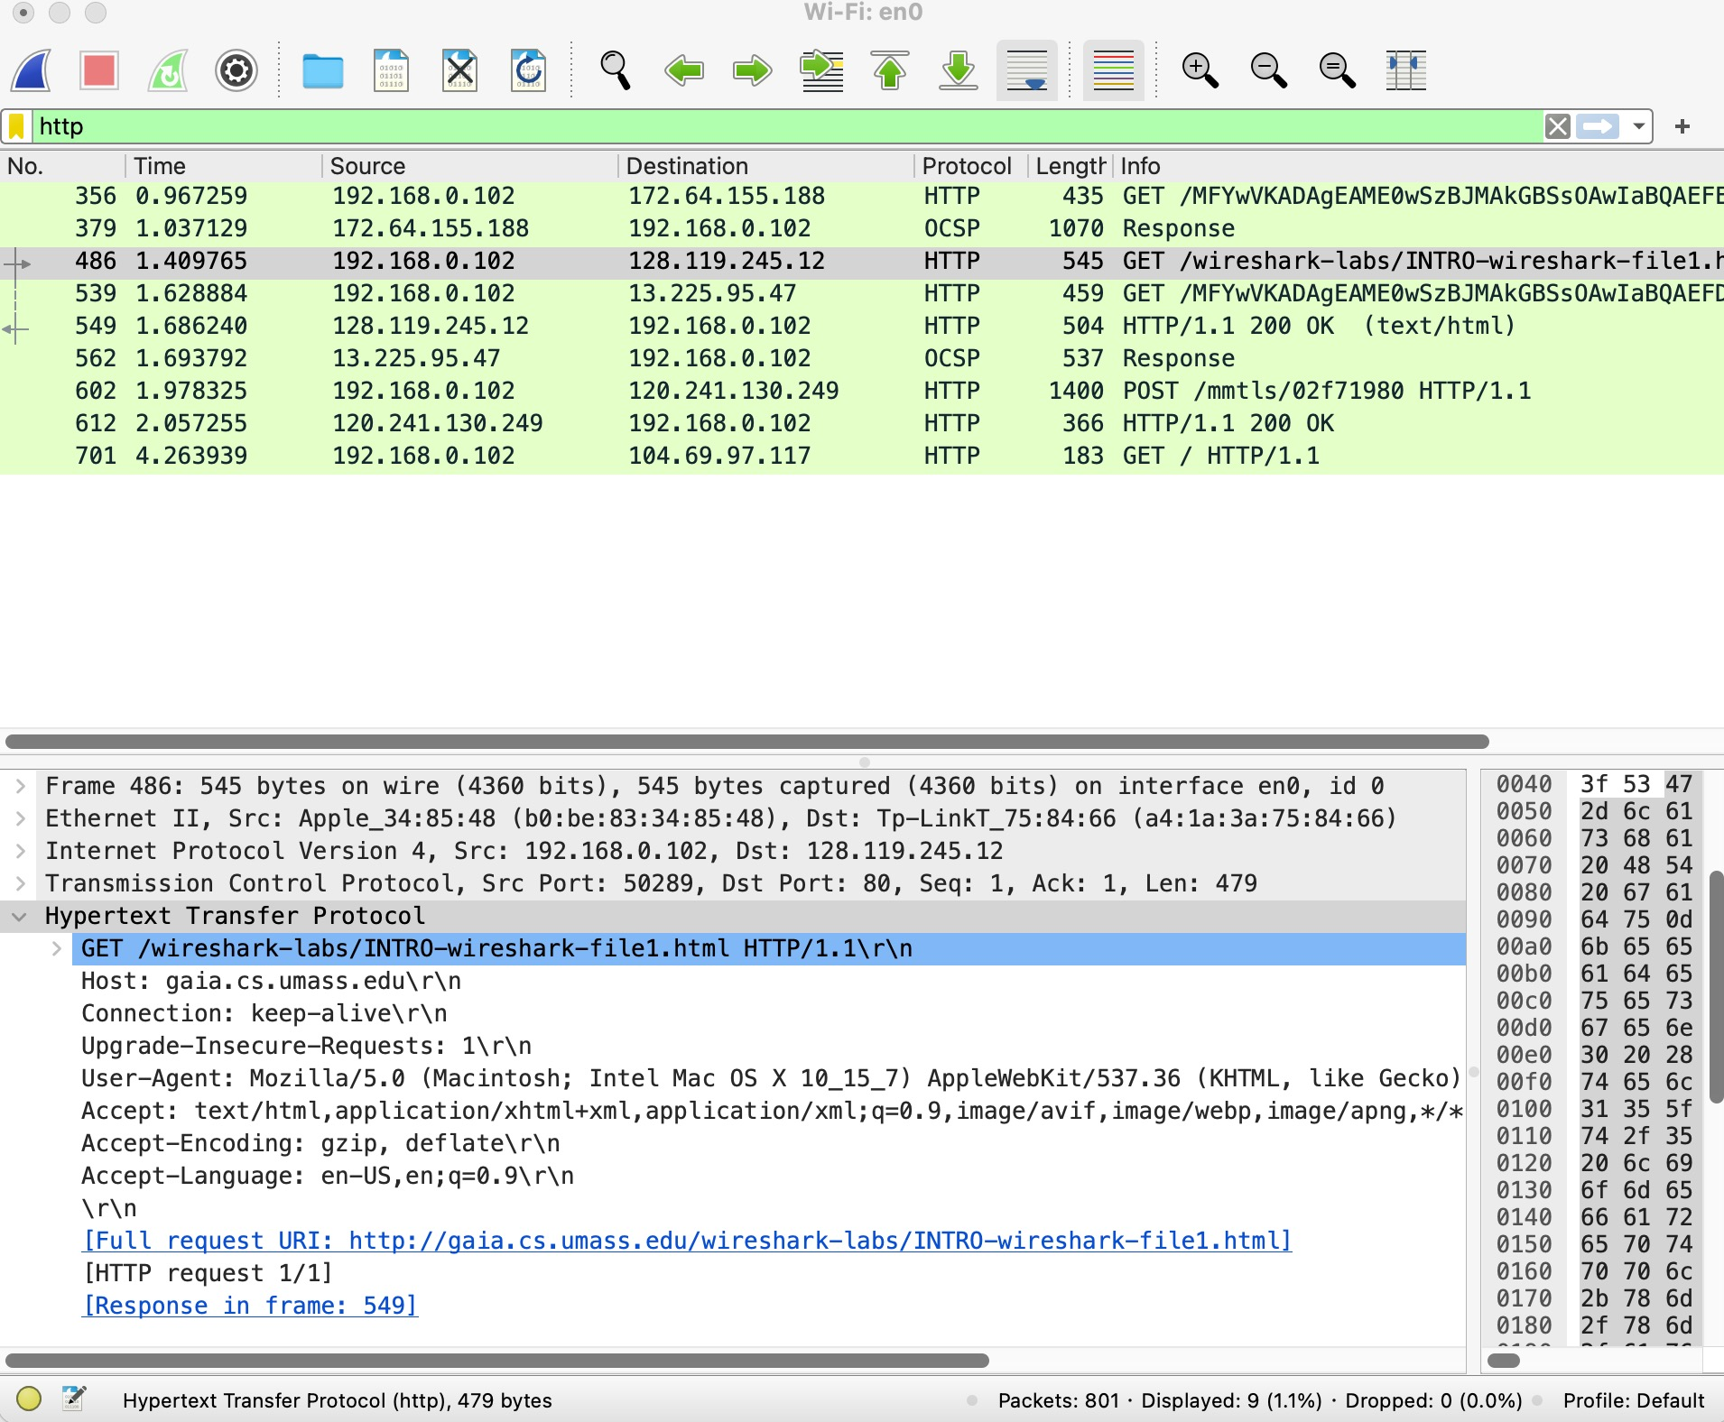
Let’s capture some interesting packets!
3. Type in http into the display filter specification window at the top of the main Wireshark window and then select Apply. This will cause only HTTP message to be displayed in the packet-listing window.

Slide 35
Let’s capture some interesting packets!
4. Find the HTTP GET message that was sent from your computer to the gaia.cs.umass.edu HTTP server.
Congratulations! You’ve now completed the first lab!

Slide 36


Let’s capture some interesting packets!
Try it on your computer and see what you get! (10mins)
Click “capture” on Wireshark
Click the website on our web browser:
http://gaia.cs.umass.edu/wireshark-labs/INTRO-wireshark-file1.html
Click ”stop” on Wireshark
Click

Slide 37
Goals of this lesson
Wireless networks protocols & analysis via Wireshark
Overview
Application layer
HTTP
Transport layer
TCP
UDP

Slide 38
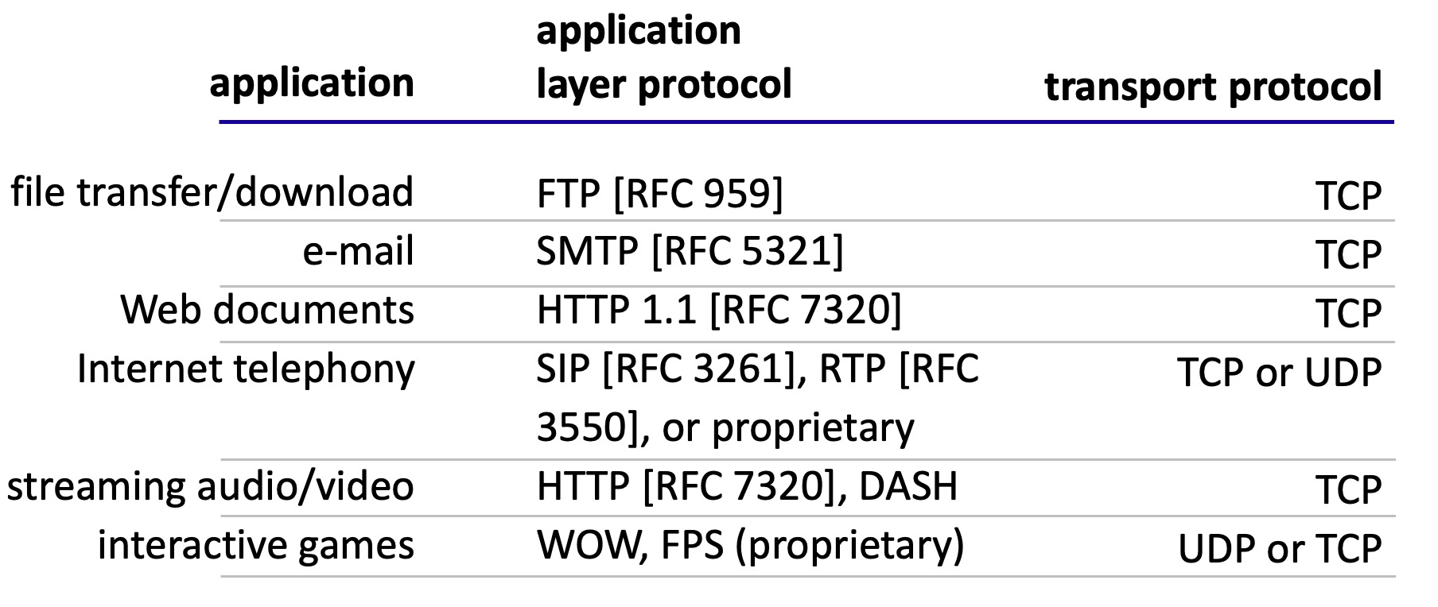
Application layer protocol analysis
Internet applications, and transport protocols

Slide 39
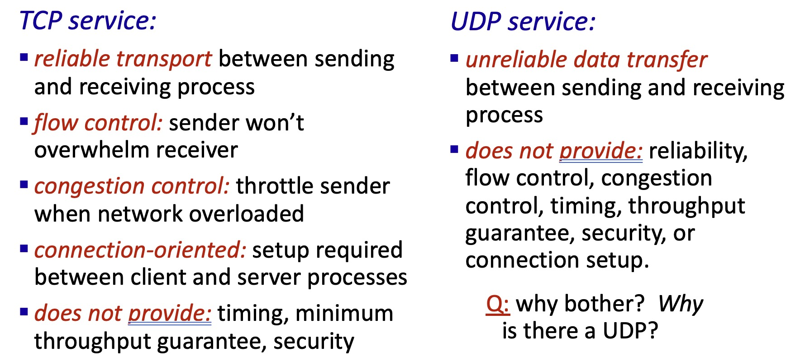
Application layer protocol analysis
Internet transport protocols services

Slide 40
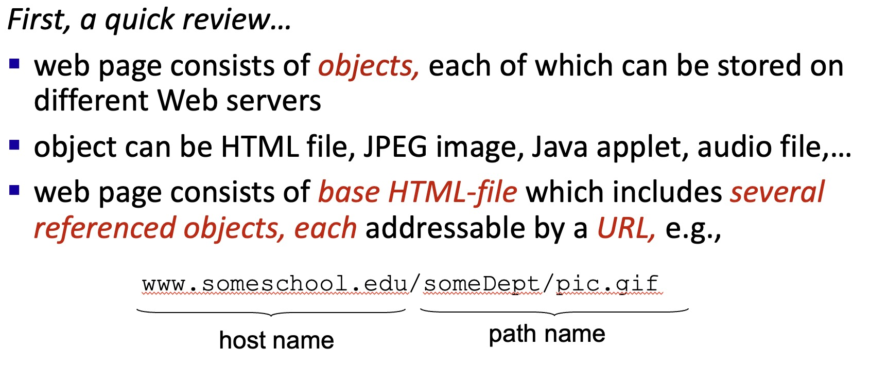
HTTP Protocol

Slide 41
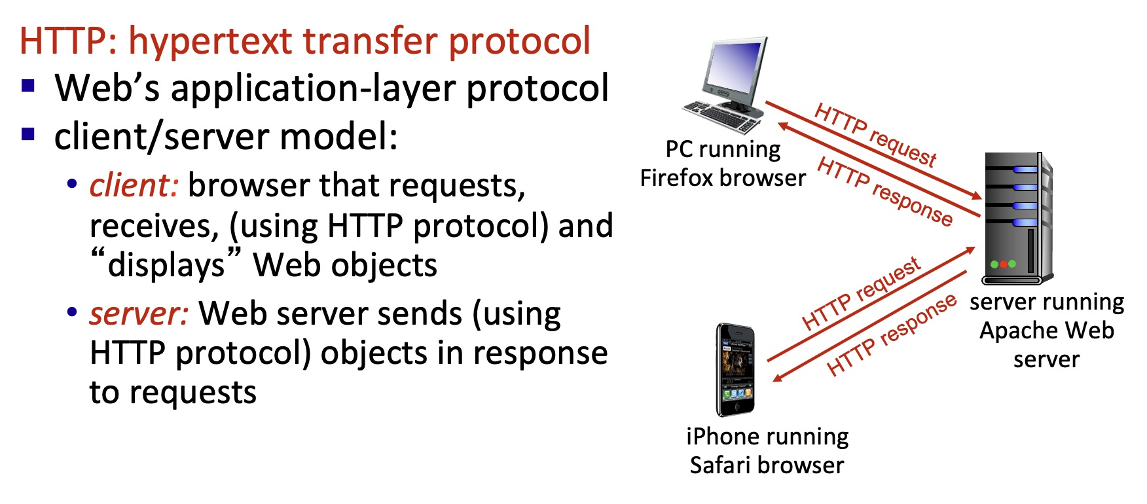
HTTP Overview

Slide 42
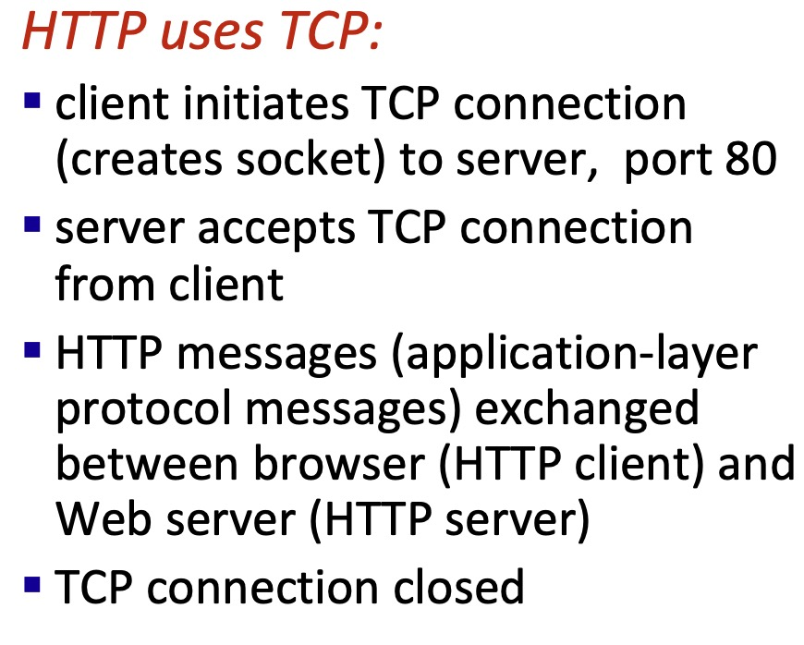
HTTP Connection via TCP
two types of HTTP messages: request, response

Slide 43
HTTP request&response messages
HTTP request message:
ASCII (human-readable format)
carriage return character
request line (GET, POST,
HEAD commands)
line-feed character
GET /index.html HTTP/1.1\r\n
Host: www-net.cs.umass.edu\r\n
User-Agent: Mozilla/5.0 (Macintosh; Intel Mac OS X 10.15; rv:80.0) Gecko/20100101 Firefox/80.0 \r\n
Accept: text/html,application/xhtml+xml\r\n
Accept-Language: en-us,en;q=0.5\r\n
Accept-Encoding: gzip,deflate\r\n
Connection: keep-alive\r\n
\r\n
header
lines
carriage return, line feed at start of line indicates end of header lines
* Check out the online interactive exercises for more examples: http://gaia.cs.umass.edu/kurose_ross/interactive/

Slide 44
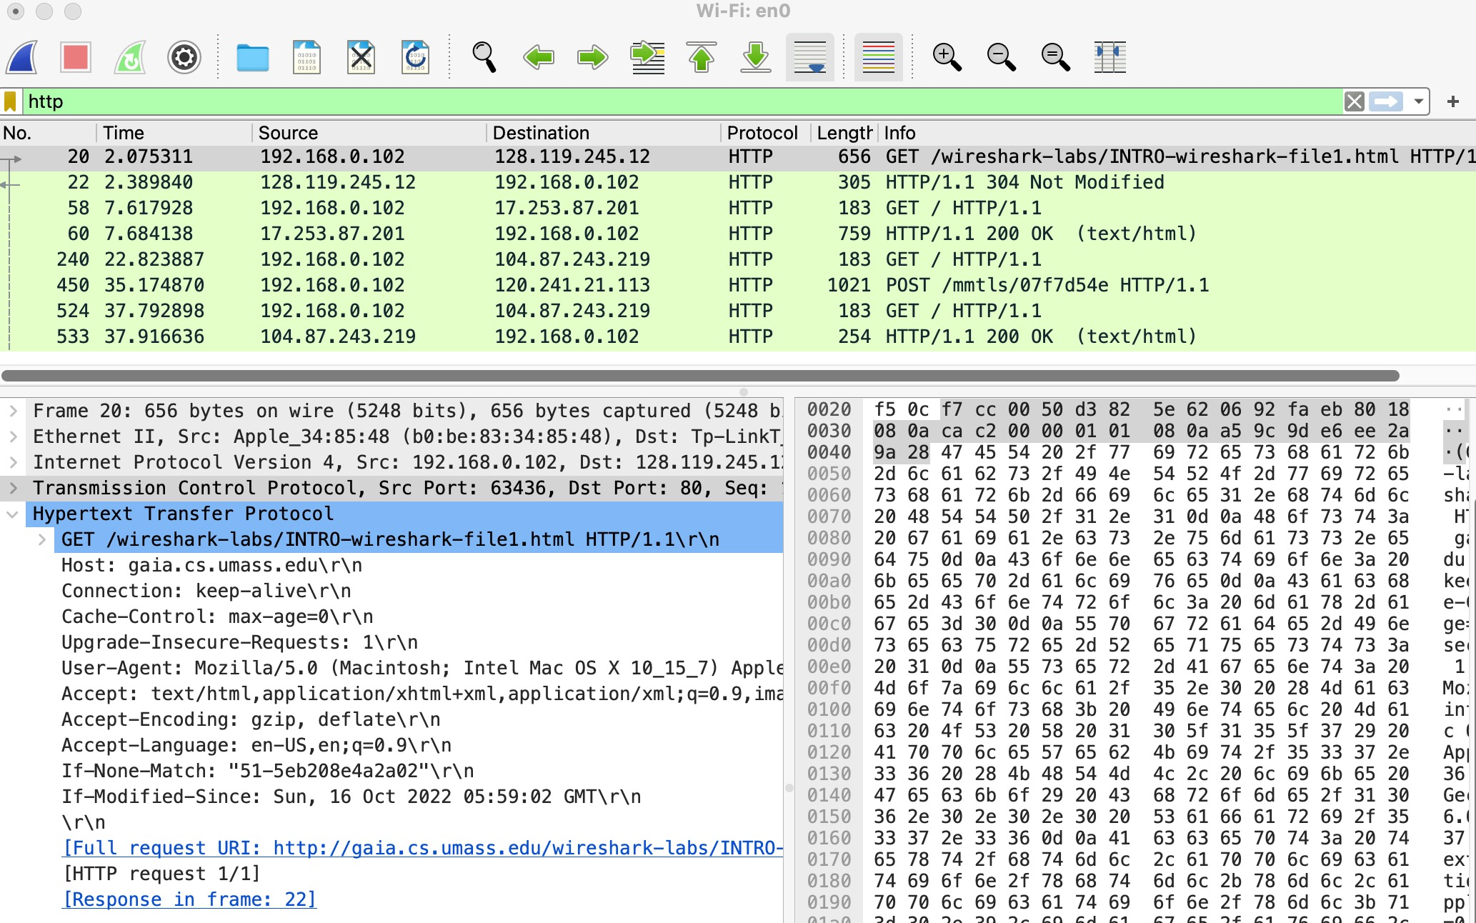
HTTP request message
HTTP request message on Wireshark:

Slide 45
HTTP response message
status line (protocol
status code status phrase)
HTTP/1.1 200 OK
Date: Tue, 08 Sep 2020 00:53:20 GMT
Server: Apache/2.4.6 (CentOS) OpenSSL/1.0.2k-fips PHP/7.4.9 mod_perl/2.0.11 Perl/v5.16.3
Last-Modified: Tue, 01 Mar 2016 18:57:50 GMT
ETag: "a5b-52d015789ee9e"
Accept-Ranges: bytes
Content-Length: 2651
Content-Type: text/html; charset=UTF-8
\r\n
data data data data data ...
header
lines
data, e.g., requested
HTML file
* Check out the online interactive exercises for more examples: http://gaia.cs.umass.edu/kurose_ross/interactive/

Slide 46
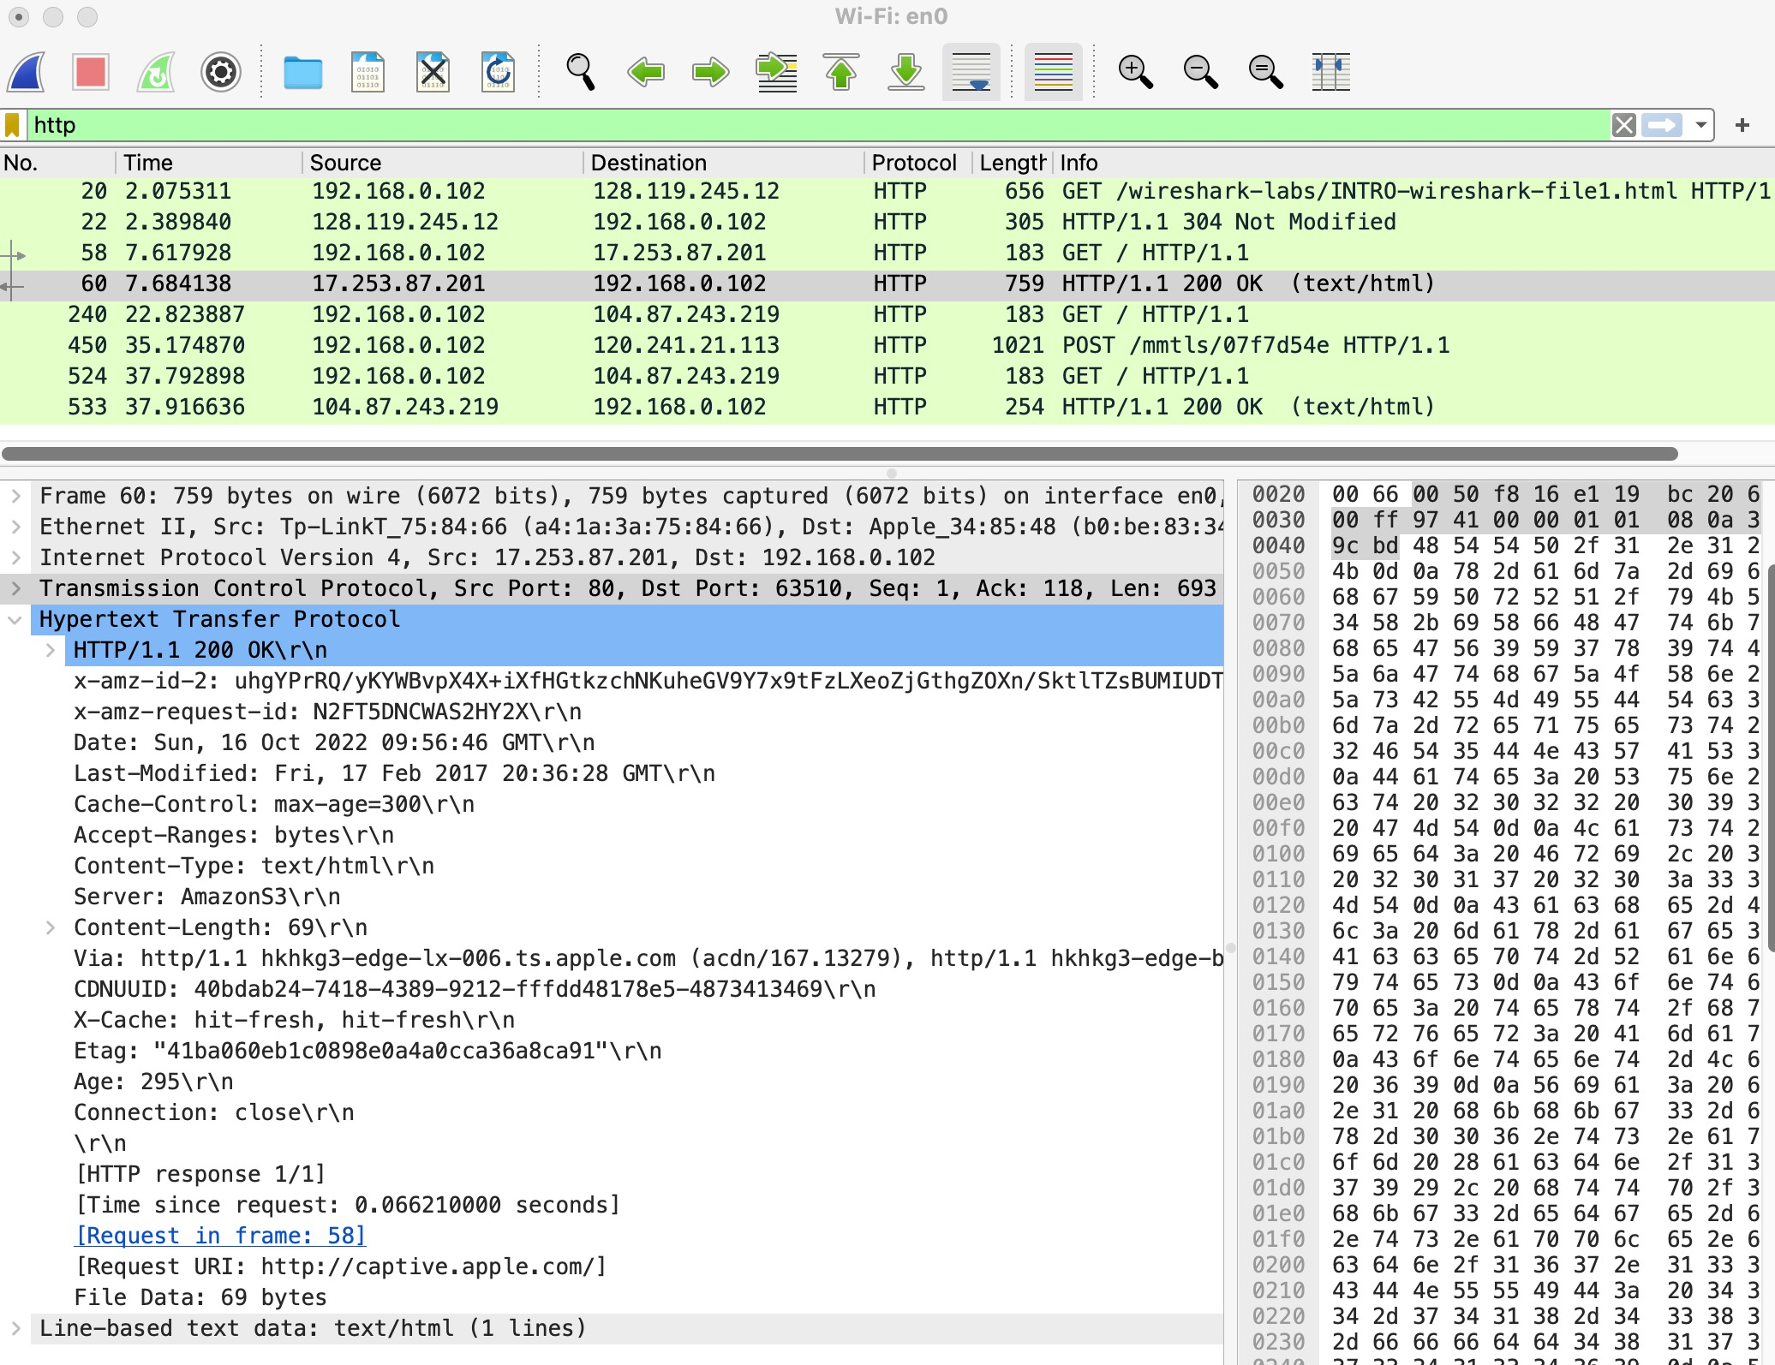
HTTP response message

Slide 47
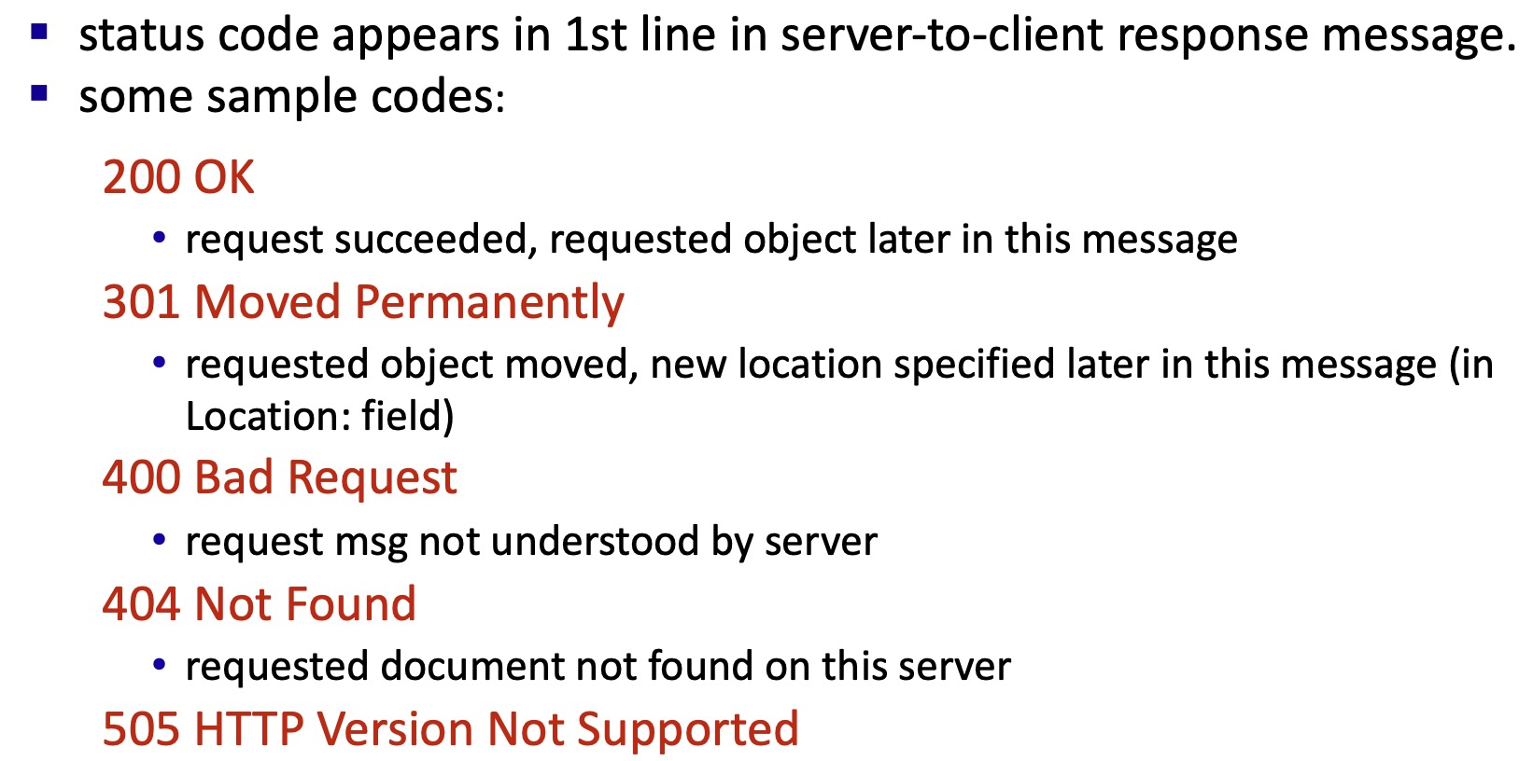
HTTP response status codes

Slide 48
Learn the basic HTTP GET/response interaction via Wireshark
1. Start up your web browser.
2. Start up the Wireshark packet sniffer and enter “http”.
3. Wait a bit more than one minute and then begin Wireshark packet capture.
4. Enter the following into your browser:
http://gaia.cs.umass.edu/wireshark-labs/HTTP-wireshark-file1.html
5. Stop Wireshark packet capture.

Slide 49
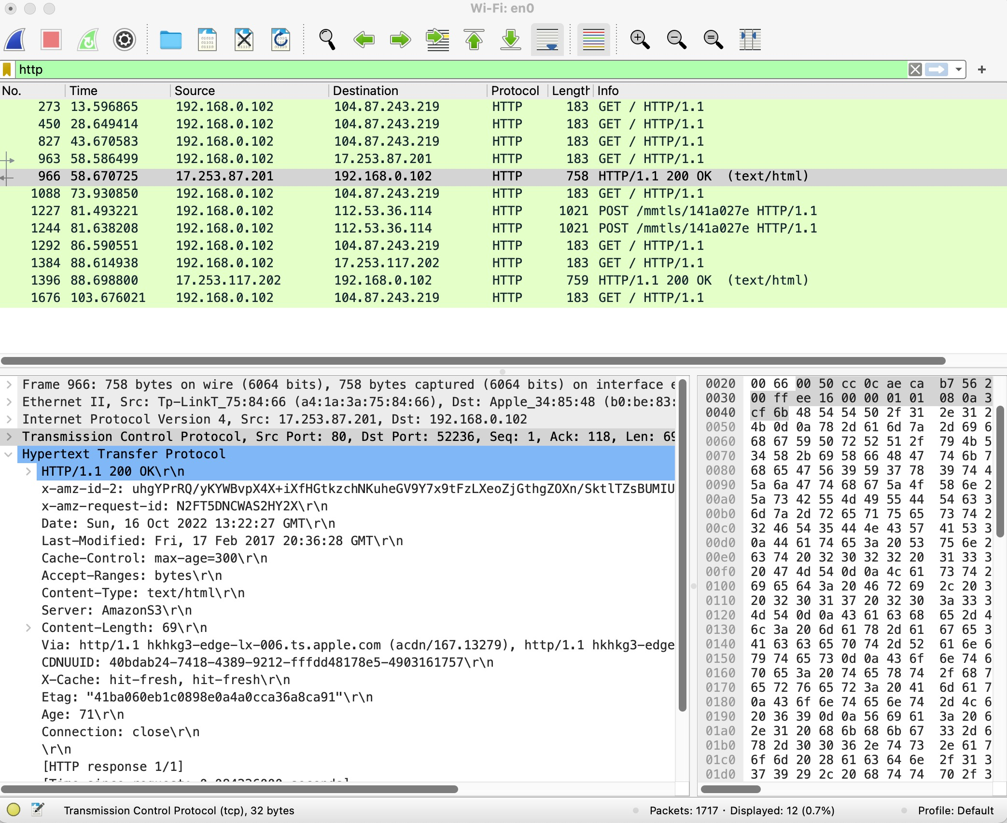
Learn the basic HTTP GET/response interaction via Wireshark
Try on your own computer!
How about streaming video? Type a online video website and try it! (5mins)

Slide 50
Goals of this lesson
Wireless networks protocols & analysis via Wireshark
Overview
Application layer
HTTP
Transport layer
TCP
UDP

Slide 51
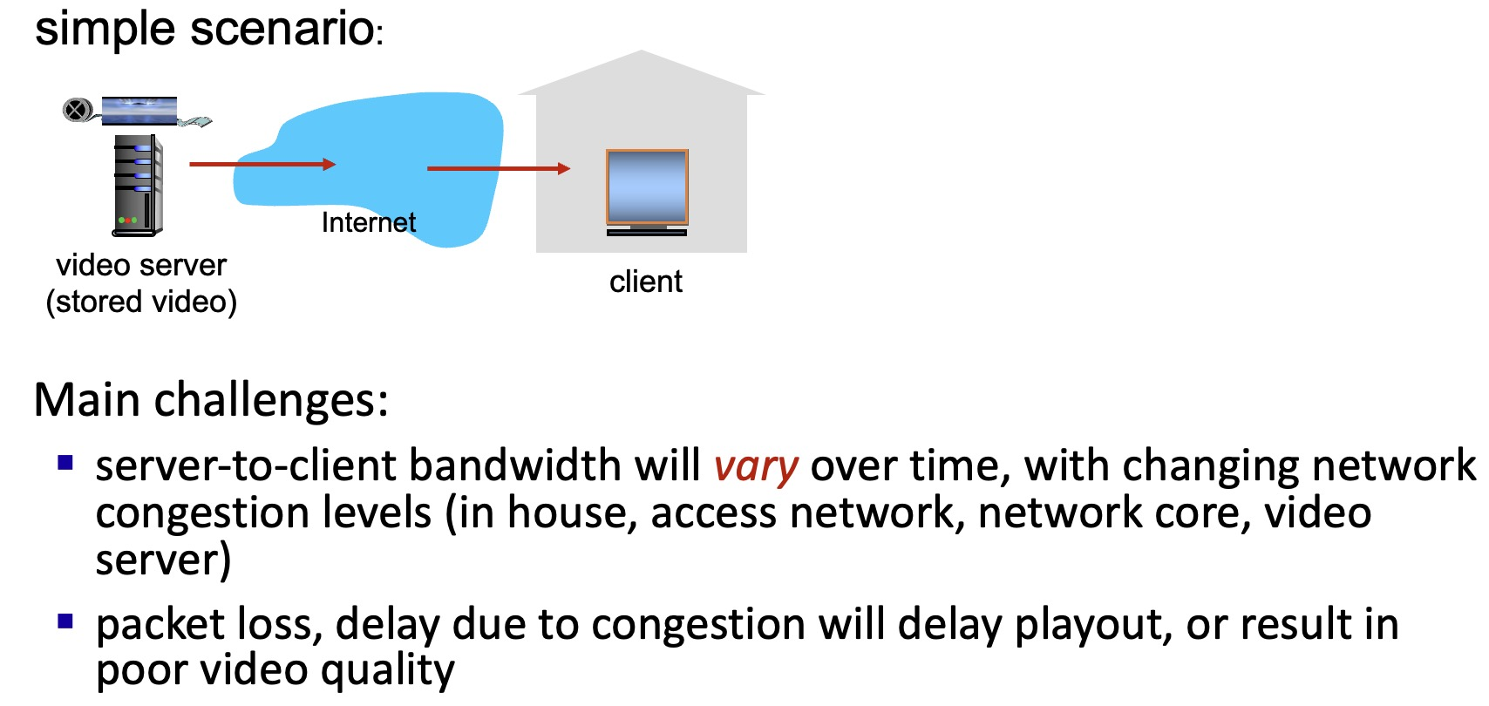
Streaming video
So, stream video uses TCP or UDP? Try to answer it!

Slide 52

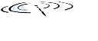










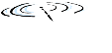


Transport services and protocols
application
transport
network
data link
physical
provide logical communication between application processes running on different hosts
mobile network
national or global ISP
transport protocols actions in end systems:
sender: breaks application messages into segments, passes to network layer
receiver: reassembles segments into messages, passes to application layer
logical end-end transport
local or regional ISP
home network
content
provider
network
application
transport
network
data link
physical
datacenter
network
two transport protocols available to Internet applications
TCP, UDP
enterprise
network
Notes:
By logical communication , we
mean that from an application’s perspective, it is as if the hosts running the processes
were directly connected; in reality, the hosts may be on opposite sides of the
planet, connected via numerous routers and a wide range of link types. Application
processes use the logical communication provided by the transport layer to send
messages to each other, free from the worry of the details of the physical infrastructure
used to carry these messages.
Let’s look at each of these three (logical communications, actions,

Slide 53
Transport Layer Actions
Sender:
is passed an application-layer message
application
application
app. msg
determines segment header fields values
T_{h}
transport
app. msg
transport
T_{h}
creates segment
network (IP)
network (IP)
passes segment to IP
link
link
physical
physical

Slide 54
Transport Layer Actions
Receiver:
application
receives segment from IP
application
checks header values
transport
transport
app. msg
extracts application-layer message
network (IP)
network (IP)
demultiplexes message up to application via socket
link
link
physical
physical
app. msg
T_{h}

Slide 55
Two principal Internet transport protocols
application
transport
network
data link
physical
TCP: Transmission Control Protocol
reliable, in-order delivery
congestion control
flow control
connection setup
UDP: User Datagram Protocol
unreliable, unordered delivery
no-frills extension of “best-effort” IP
services not available:
delay guarantees
bandwidth guarantees
mobile network
national or global ISP
logical end-end transport
local or regional ISP
home network
content
provider
network
application
transport
network
data link
physical
datacenter
network
enterprise
network

Slide 56
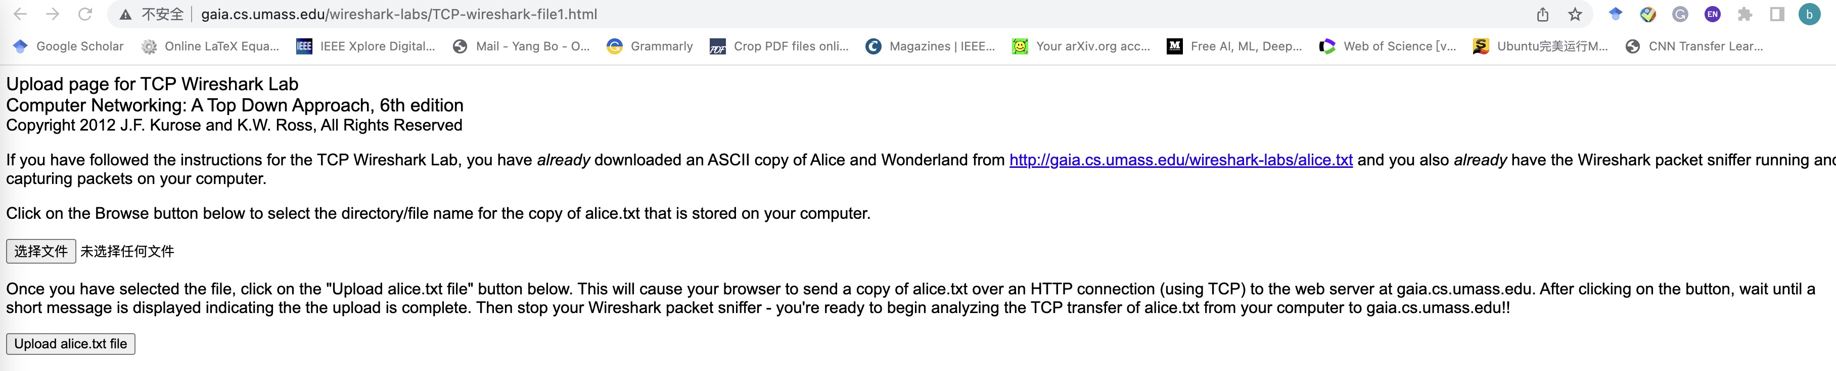

Capturing a bulk TCP transfer from your computer to a remote server
1. Start up your web browser. Go the http://gaia.cs.umass.edu/wiresharklabs/alice.txt and retrieve an ASCII copy of Alice in Wonderland. Store this file somewhere on your computer.
2. Go to http://gaia.cs.umass.edu/wireshark-labs/TCP-wireshark-file1.html. You should see a screen that looks like:

Slide 57
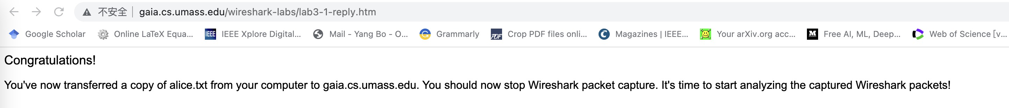


Capturing a bulk TCP transfer from your computer to a remote server
3. Use the Browse button in this form to enter the name of the file (full path name) on your computer containing Alice in Wonderland (or do so manually). Don’t yet press the “Upload alice.txt file” button.
4. Now start up Wireshark and begin packet capture (Capture->Start) and then press OK on the Wireshark Packet Capture Options screen.
5. Returning to your browser, press the “Upload alice.txt file” button to upload the file to the server.
6. Stop Wireshark packet capture.

Slide 58
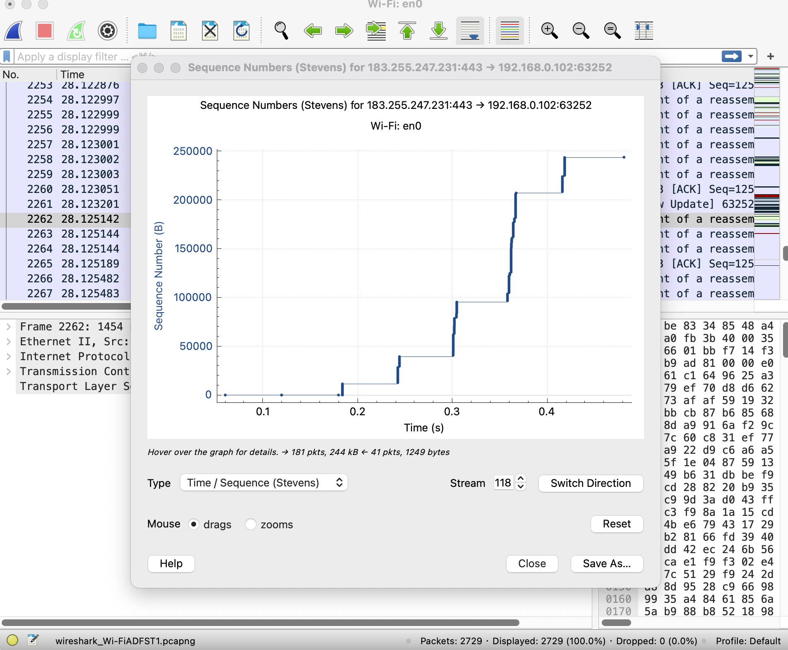
TCP congestion control in action
Select a TCP segment in Wireshark’s “listing of captured-packets” window. Then select the menu : Statistics->TCP Stream Graph-> Time-Sequence-Graph(Stevens).
Q: What do you learn from the figure?
More congestions occur, the smaller
congestion window size!
Q: Where TCP’s slowstart phase
begin and ends?

Slide 59
UDP: User Datagram Protocol
UDP use:
streaming multimedia apps (loss tolerant, rate sensitive)
DNS
SNMP
HTTP/3
if reliable transfer needed over UDP (e.g., HTTP/3):
add needed reliability at application layer
add congestion control at application layer

Slide 60
UDP: User Datagram Protocol
Why is there a UDP?
“best effort” service, UDP segments may be:
lost
delivered out-of-order to app
no connection establishment (which can add RTT delay)
simple: no connection state at sender, receiver
small header size
no congestion control
UDP can blast away as fast as desired!
can function in the face of congestion
connectionless:
no handshaking between UDP sender, receiver
each UDP segment handled independently of others

Slide 61
UDP: Transport Layer Actions
SNMP client
SNMP server
application
application
transport
(UDP)
transport
(UDP)
network (IP)
network (IP)
link
link
physical
physical

Slide 62
UDP: Transport Layer Actions
SNMP client
SNMP server
UDP sender actions:
application
application
is passed an application-layer message
SNMP msg
transport
(UDP)
transport
(UDP)
determines UDP segment header fields values
UDP_{h}
SNMP msg
UDP_{h}
creates UDP segment
network (IP)
network (IP)
passes segment to IP
link
link
physical
physical

Slide 63
UDP: Transport Layer Actions
SNMP client
SNMP server
UDP receiver actions:
application
receives segment from IP
application
checks UDP checksum header value
transport
(UDP)
transport
(UDP)
SNMP msg
extracts application-layer message
network (IP)
network (IP)
SNMP msg
UDP_{h}
demultiplexes message up to application via socket
link
link
physical
physical

Slide 64
UDP segment header
32 bits
source port #
dest port #
length
checksum
application
data
(payload)
length, in bytes of UDP segment, including header
data to/from application layer
UDP segment format

Slide 65

UDP checksum
Goal: detect errors (i.e., flipped bits) in transmitted segment
1st number
2nd number
sum
Transmitted: 5 6 11
Received: 4 6 11
receiver-computed
checksum
=
sender-computed
checksum (as received)

Slide 66
UDP checksum
Goal: detect errors (i.e., flipped bits) in transmitted segment
sender:
treat contents of UDP segment (including UDP header fields and IP addresses) as sequence of 16-bit integers
checksum: addition (one’s complement sum) of segment content
checksum value put into UDP checksum field
receiver:
compute checksum of received segment
check if computed checksum equals checksum field value:
Not equal - error detected
Equal - no error detected.

Slide 67
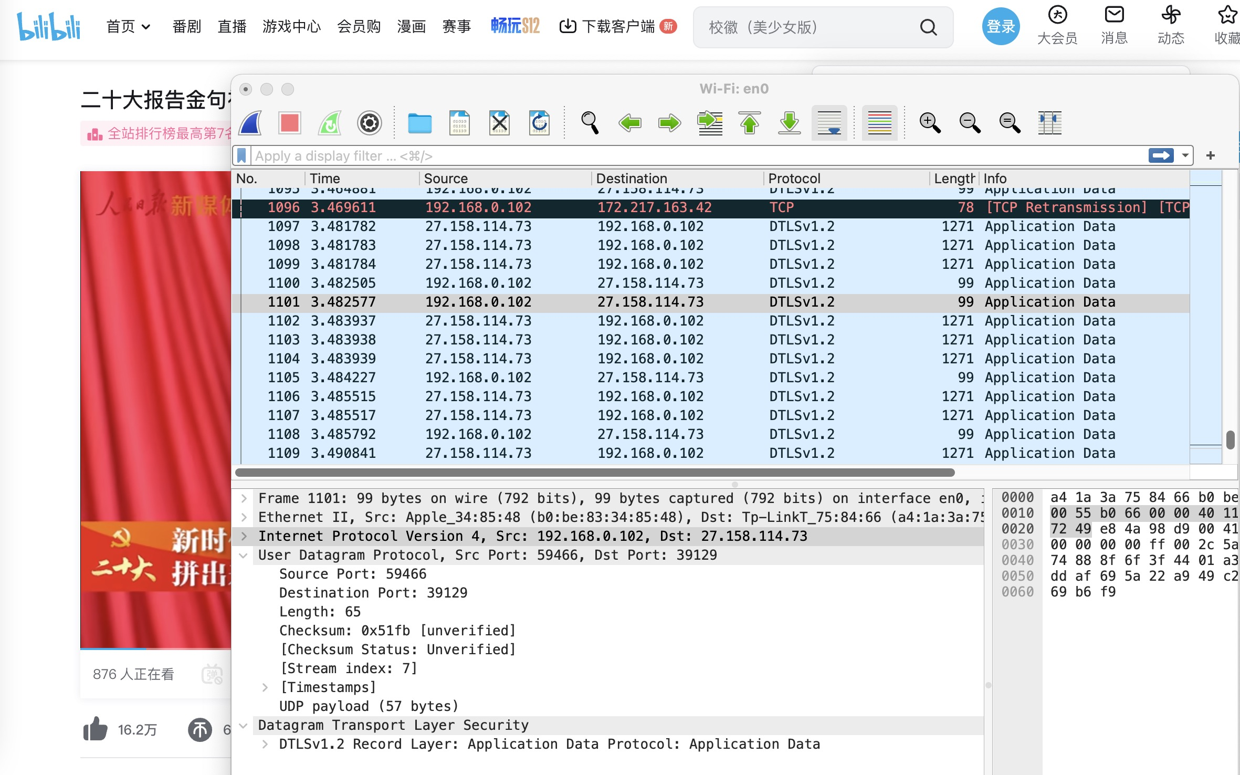
Video streaming capture
www.bilibili.com

Slide 68
Video streaming capture
Try to do it on your computer and show us what you get!

Slide 69
Thank you for your listening!
Q&A and Discussions!
Homework

